Slide 1

HEALTH SURVEILLANCE OF PREMISES (NPO)
BY
Ms. Kamogelo Tele
Environmental Health Practitioner
Ekurhuleni Health District Mental Health

Slide 2
Definitions
Surveillance- Refers to the continuous, specific measurement and observation for the purpose of water quality management and operational activities.
Premises-means any building, structure or tent together with the land on which it is situated and the adjoining land used in connection with it and includes any land without any building, structure or tent and any vehicle, conveyance or ship.
Mental NPO Health Care Provider- Non profit organization that provides mental health services.
Mental Health Care User (MHCU)- Means a child or adult or older person with severe psychiatric disability or severe or profound intellectual disability, who is a recipient of the Service provider services.
Mental Health Facility- means a facility that provides a daycare or residential care , treatment and rehabilitation services to five or more persons with mental illness and/or severe or profound intellectual disability.

Slide 3
Introduction
Health surveillance of premises is a function performed by Environmental Health Practitioners (EHPs) in South Africa to monitor and assess conditions in various types of premises, such as housing, public buildings, and businesses, to identify and mitigate health hazards. This process includes evaluating factors like air quality, lighting, structural safety, and ensures compliance with health legislation to protect public health by promoting safe and hygienic environments.

Slide 4
Background on NPOs
The mental health NPOs are non profit organizations which provide day care, residential care, treatment, rehabilitation services to five or more persons with metal illness and/or severe to profound intellectual disability, the services which should be provided at these NPOs as outlined in the National standards for health establishments in South Africa focus on:

Slide 5
Continued..
Mental Health Care Users.
2. The Facility Services.
3. The Clinical Care.
4. The Environment.

Slide 6
Standards for Health Surveillance of Premises
Conducting EH impact assessments of, amongst others housing projects.
Assessing aspects such as ventilation and indoor air quality, lighting, moisture proofing, thermal quality, structural safety and floor space.
Assessing overcrowded, dirty or other unsatisfactory health conditions on any residential, commercial, industrial or other occupied premises.

Slide 7
Standards for Health Surveillance of Premises
Monitoring all buildings and all other permanent or temporary physical structures used for residential, public or institutional purposes (including health care and other care, detainment, work, recreational, travel, tourism, holidaying and camping) and the facilities in connection therewith the immediate precincts.
Ensuring urban and rural land use planning and practices that is conducive to sustainable development conducting sound EH impact and other assessments.
Ensuring the prevention and abatement of any condition on any premises, which is likely to constitute and health hazard.

Slide 8
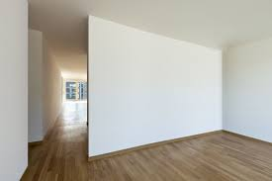
Elements of Health Surveillance of Premises(NPO)
Walls
The walls should be constructed of brick, stone ,concrete or other impervious material. The walls should be painted and without cracks.

Slide 9
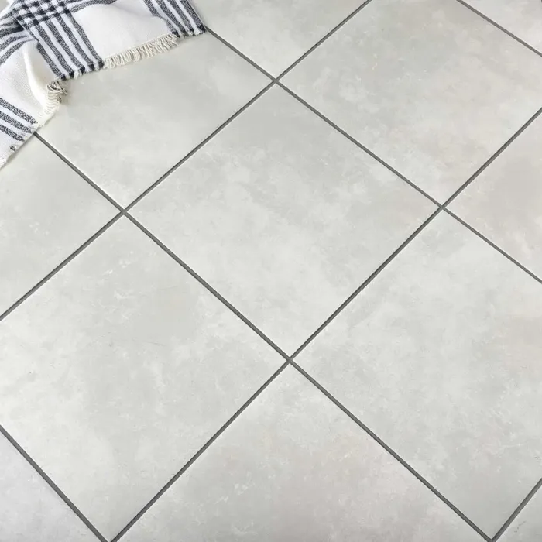
Elements of Health Surveillance of Premises(NPO)
Floors
Are constructed of concrete, hardwood or other durable material and brought to a smooth finish. The floors in the recreation areas should be free from dust.

Slide 10
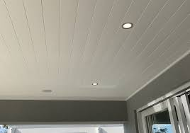
Elements of Health Surveillance of Premises(NPO)
Ceiling
Ceilings must be constructed so as not to attract dust and should be painted with light colored paint.

Slide 11
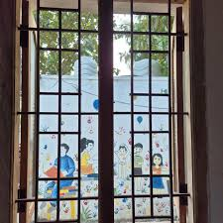
Elements of Health Surveillance of Premises(NPO)
Windows
Windows in the rooms should be adequately protected or guarded to ensure the safety of MHCUs. The window design should allow for light and natural ventilation without breaching security. The Mental Health Care Users should not be able to break the glass and injure him/herself. Windows must be constructed so as to minimize windowpane breakage. Window frames must be able to withstand repeated attempts at dismantling.

Slide 12
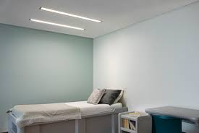
Elements of Health Surveillance of Premises(NPO)
Illumination
As much natural lighting as possible should be provided. It should be noted that confused mental healthcare users have disturbed day and night rhythms and daylight assists in patient orientation to time and space.
Recessed illumination should be used and the patient should not be able to reach or break the light.

Slide 13
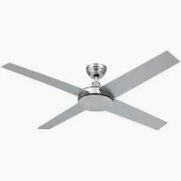
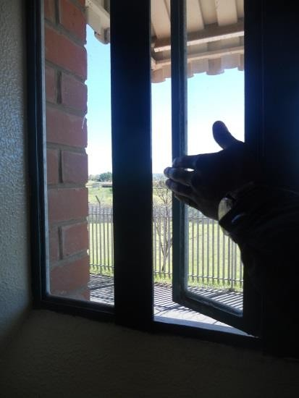
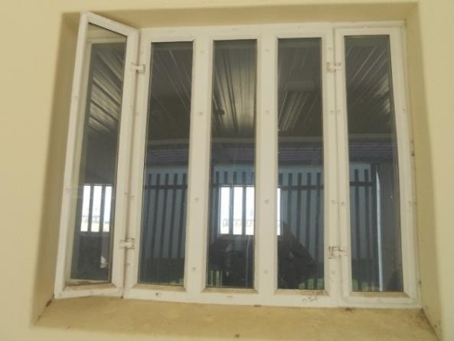
Elements of Health Surveillance of Premises(NPO)
Ventilation
There should be sufficient natural ventilation within the Centre, ventilation can also be achieved by artificial means ( air conditioners and fans).

Slide 14
Elements of Health Surveillance of Premises(NPO)
Ablution facilities
Mental healthcare users should have access to appropriate ablution facilities.
The design of ablution facilities should take into consideration people living with disabilities.
Ablution facilities should include hand wash basin and all the amenities for proper hand washing techniques.
All plumbing is to be chased into walls and plastered over.

Slide 15
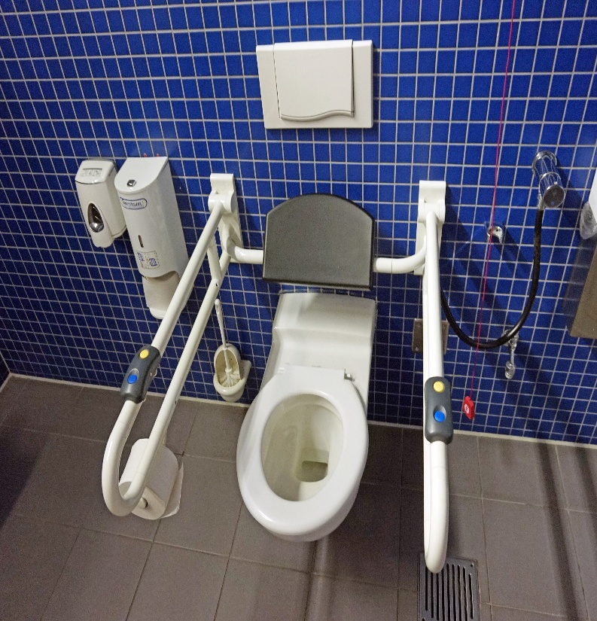
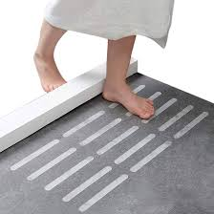
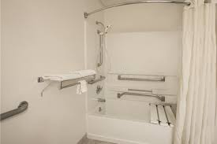
Elements of Health Surveillance of Premises(NPO
Ablution Facilities.
Where possible showers and bath tubs should also be fitted with non slip floor mats to avoids injuries.
The ablution facilities should have both hot and cold water available.

Slide 16
Elements of Health Surveillance of Premises(NPO
Kitchen
The food preparation area is audited once a quarter and or when close monitoring is required.
The food preparation area must be compliant in terms of the relevant Municipal Bi-laws.
The food preparation area should also have all the required amenities e.g. stove,refridgerator.
The inspections are conducted to ensure that the food preparation area:
-has availability of Water.
- waste is properly managed.
- hygiene practices are followed.
-Pest control methods are adhered to.

Slide 17
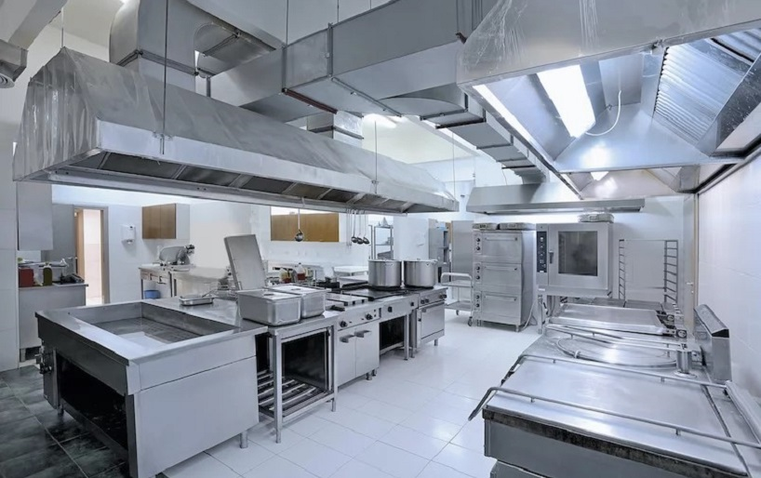
Elements of Health Surveillance of Premises(NPO
Kitchen
food safety is also ensured through:
- Regular food safety trainings.
- Food sampling.
- Ensuring food is kept in compliant storage areas, with the use of the FIFO method.

Slide 18
COMPLIANCE
The afore mentioned elements are minimum requirements that NPOs should adhere to in order to be deemed environmentally compliant.
The Environmental Health discipline was a lacking aspect pre-life Esidimeni and it was fitting as a mitigation stratergy to involove Environmental Health Practitioner to prevent an incident of that magnitude to occur in future.

Slide 19
Compliance
The Health surveillance of premises (NPOs) is important in ensuring that the Mental Health Stratergy and aspects of the Mental Health act( act 17 of 2002) are achieved in all Mental Health NPOs.

Slide 20

Conclusion
The Health surveillance of premises is necessary in the mental health program to ensure that the care,treatment and rehabilitation of mental health care users is conducted in a conducive environment that poses no harm to the mental health care user.
Life Esidimeni was an unfortunate occurance in the Gauteng Dapertment of Health system and such an incident can be prevented through implementation of Environmental Health standards by all mental health care providers.

Slide 21
REFERENCES
National health act, act 61 OF 2003.
Mental Health act, act 17 0f 2002.
Foodstuffs, cosmetics and disinfectants act, act 54 of 1972.
National environmental health norms & standards for premises and acceptable standards for environmental Health Practitioners.
IUSS Health Facility guidelines.
National building regulations and building standards act, act 103 of 1977.

Slide 22
.
THANK YOU..

